Slide 1


An Overview : Deep Neural Network Based Relation Extraction
Authors : Hailin Wang, Ke Qin, Rufai Yusuf, Zakari, Guoming Lu, Jin Yin
Presented by : Jasmine Kaur
MSc Data Science and Artificial Intelligence

Slide 2
Content:
Abstract
Relation Extraction and its framework
Concepts used
Methods applied
Conclusion

Slide 3
Abstract :
Knowledge is a formal way of understanding the world, providing a human-level cognition and intelligence for the next-generation artificial intelligence (AI). One of the representations of knowledge is semantic relations between entities. An elective way to automatically acquire this important knowledge, called Relation Extraction (RE), a sub-task of information extraction, plays a vital role in Natural Language Processing (NLP). Its purpose is to identify semantic relations between entities from natural language text. To date, there are several studies for RE in previous works, which have documented these techniques based on Deep Neural Networks (DNNs) become a prevailing technique in this research. Especially, the supervised and distant supervision methods based on DNNs are the most popular and reliable solutions for RE. This article 1) introduces some general concepts, and further 2) gives a comprehensive overview of DNNs in RE from two points of view: supervised RE, which attempts to improve the standard RE systems, and distant supervision RE, which adopts DNNs to design sentence encoder and de-noise method. We further 3) cover some novel methods and recent trends as well as discuss possible future research directions for this task.
Keywords : Information Extraction, Relation Extraction, Neural Networks

Slide 4
Relation Extraction
Relationship extraction is the task of extracting semantic relationships from a text.
Extracted relationships usually occur between two or more entities of a certain type (e.g. Person, Organisation, Location) and fall into a number of semantic categories (e.g. married to, employed by, lives in).
One aim of RE is to process the human language text, to find unknown relational facts from a plain text, organizing unstructured information into structured information.

Slide 5
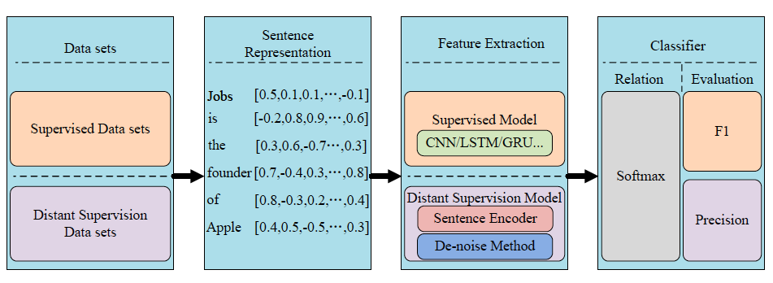
Framework

Slide 6

Concept Used
Neural Network : Use of CNN and RNN .
Word Embedding : a class of techniques where individual words are represented as real-valued vectors in a predefined vector space.
Position Embedding : provides a uniform way for the RE model to be aware of word positions.
Shortest Dependancy path : is a word-level de-noise method and derived from a grammatical dependency tree, which masks irrelevant words influencing the relation of entities in a sentence

Slide 7
Methods Applied
Supervised methods :
Considers RE as a multiclass classificaiton problem.
To facilitate the analysis, the development process of each type of model set is divided into two subtypes according to the evolution of model structure.
The structure-oriented classes improve the ability of feature extraction by changing the structure of the model;
the semantic-oriented classes improve the ability of semantic representation by excavating the internal association of text.

Slide 8
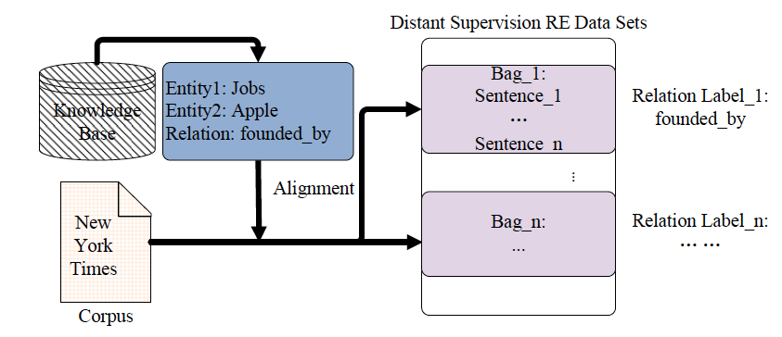
Distant supervison method :
A kind of knowledge-based or weakly supervised method. distant supervision attempts to extract the relations between entities from the text by using a KB, such as Freebase, as the supervision source.

Slide 9
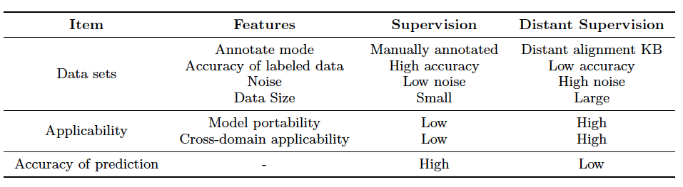
Results Obtained

Slide 10
Conclusions
This article begins by laying out the general framework and some basic concepts, focusing on DNN-based methods in supervised and distant supervision
Supervised methods are better suited for specific domain, while distant supervision methods are better for generic domains.
As a result It was difficult to specify which methods are the best.

Slide 11
Thank you

